Slide 1
COST Unit 3 Statistical Estimation Theory

Slide 2
Population Vs Sample
1

Slide 3
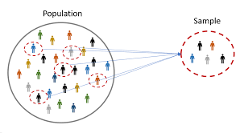
Population- The entire set of individuals or objects of interest, either infinite or finite.
Sample - subset of the population; its size is always finite.

Slide 4


Estimation Theory
The decisions made about the population based on information from sample is called as ‘Statistical Estimation’.
Examples-
To decide whether a new medicine is effective in controlling a particular disease.
Exit Polls in elections

Slide 5
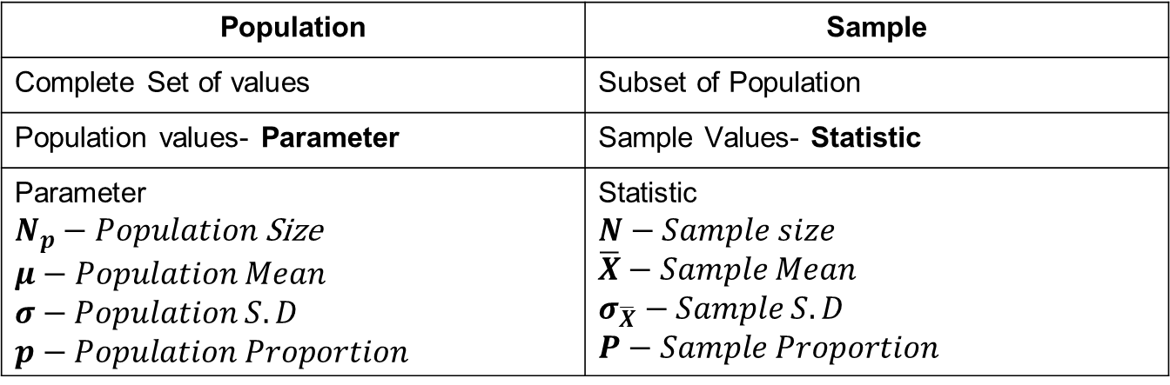
Population Vs Sample
Population | Sample
Complete Set of values | Subset of Population
Population values- Parameter | Sample Values- Statistic
Parameter $N_{p}−Population$ Size $$μ−Population Mean$$ $$σ−Population S.D$$ $$p−Population Proportion$$ | Statistic $$N−Sample size$$ $$\overline{X}−Sample Mean$$ $$σ_{\overline{X}}−Sample S.D$$ $$P−Sample Proportion$$

Slide 6
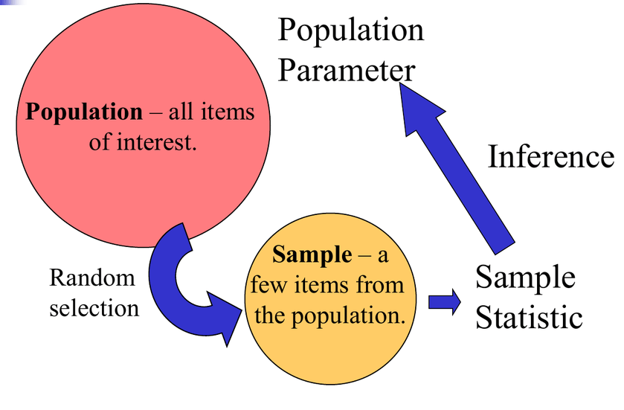

Slide 7
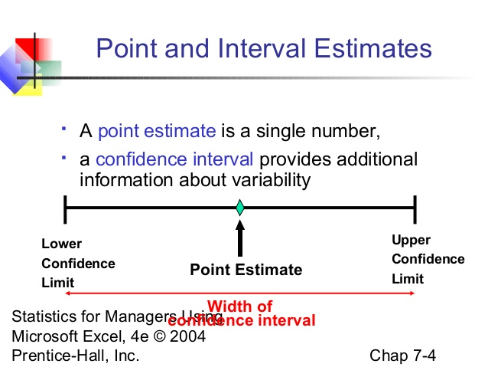
Statistical Inference: Estimation
Goal- Estimate values of population parameters from sample data
Point Estimate- A single statistic value that is the “best guess” for the parameter value.
Interval Estimate- An interval of numbers around the point estimate, that has a fixed “confidence level” of containing the parameter value. Called a Confidence Interval.

Slide 8
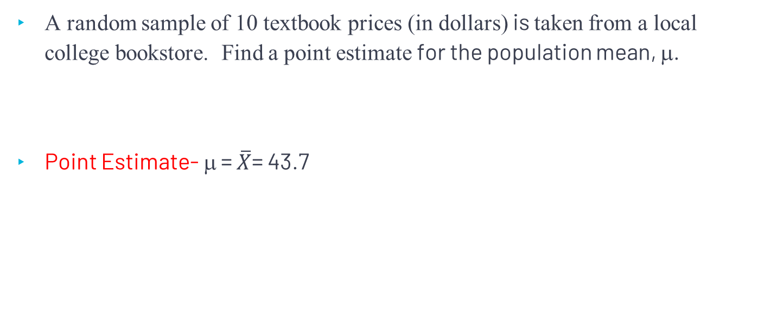


Example
A random sample of 10 textbook prices (in dollars) is taken from a local college bookstore. Find a point estimate for the population mean, μ.
Point Estimate- μ = $\overline{X}$= 43.7
34 | 36 | 38 | 45 | 48 | 44 | 39 | 54 | 51 | 48
$\overline{X}$= 43.7
$\overline{X}$= 43.7

Slide 9

Confidence Interval
How confident do we want to be that the interval estimate contains the population mean, μ?
A Confidence Interval is a range of values we are fairly sure our true value lies in.

Slide 10
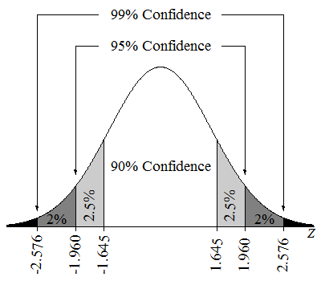
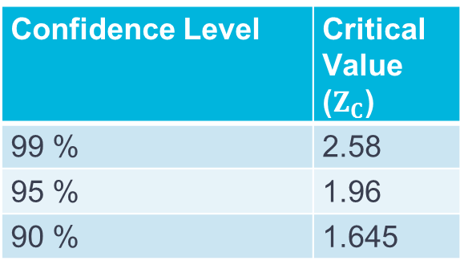
Confidence Intervals
Confidence Level | Critical Value ($Z_{C}$)
99 % | 2.58
95 % | 1.96
90 % | 1.645

Slide 11
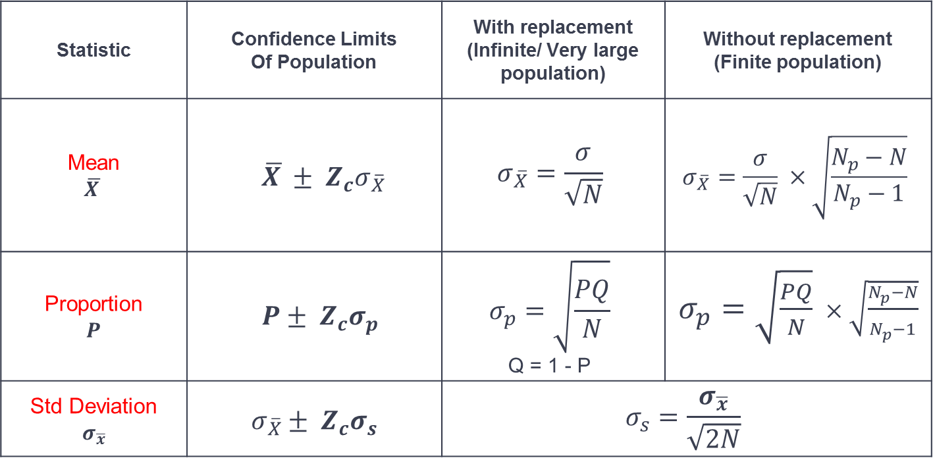
Confidence Intervals
Statistic | Confidence Limits Of Population | With replacement (Infinite/ Very large population) | Without replacement (Finite population)
Mean $$\overline{X }$$ | $$\overline{X }± Z_{c}σ_{\overline{X}}$$ | $$σ_{\overline{X}}=\frac{σ}{\sqrt{N}}$$ | $$σ_{\overline{X}}=\frac{σ}{\sqrt{N}} ×\sqrt{\frac{N_{p}−N}{N_{p}−1}}$$
Proportion $$P$$ | $$P± Z_{c}σ_{p}$$ | $$σ_{p}=\sqrt{\frac{PQ}{N}}$$ Q = 1 - P | $σ_{p}=\sqrt{\frac{PQ}{N}} ×\sqrt{\frac{N_{p}−N}{N_{p}−1}}$
Std Deviation $$σ_{\overline{x}}$$ | $$σ_{\overline{X}}± Z_{c}σ_{s}$$ | $$σ_{s}=\frac{σ_{\overline{x}}}{\sqrt{2N}}$$

